Slide 1

Real-Time Polygonal Light with LTC
Li Hongbo
Graphics Engineer

Slide 2

Agenda
Introduction Real-Time Polygonal Light
Linearly Transformed Spherical Distributions
Approximating Physically Based BRDFs with Linearly Transformed Cosines
Real-Time Polygonal-Light Shading with Linearly Transformed Cosines
Real-Time Polygonal-Light with TBDR or CBDR

Slide 3
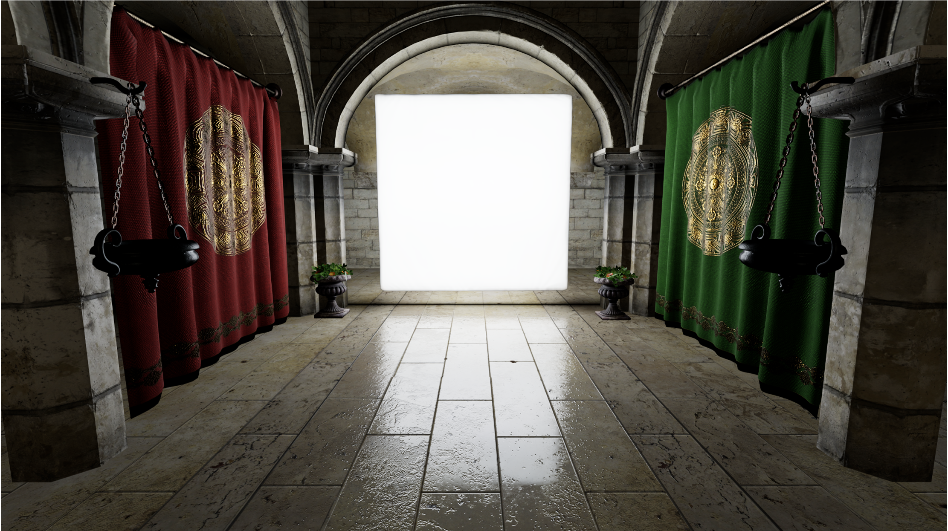
Introduction Real-Time Polygonal Light
Challenging
Integrating parametric spherical distributions over spherical polygons is difficult.
Physically based material models are not simple distributions ,they have sophisticated shapes with anisotropic stretching and skewness that need to be represented for the material to appear realistic.

Slide 4
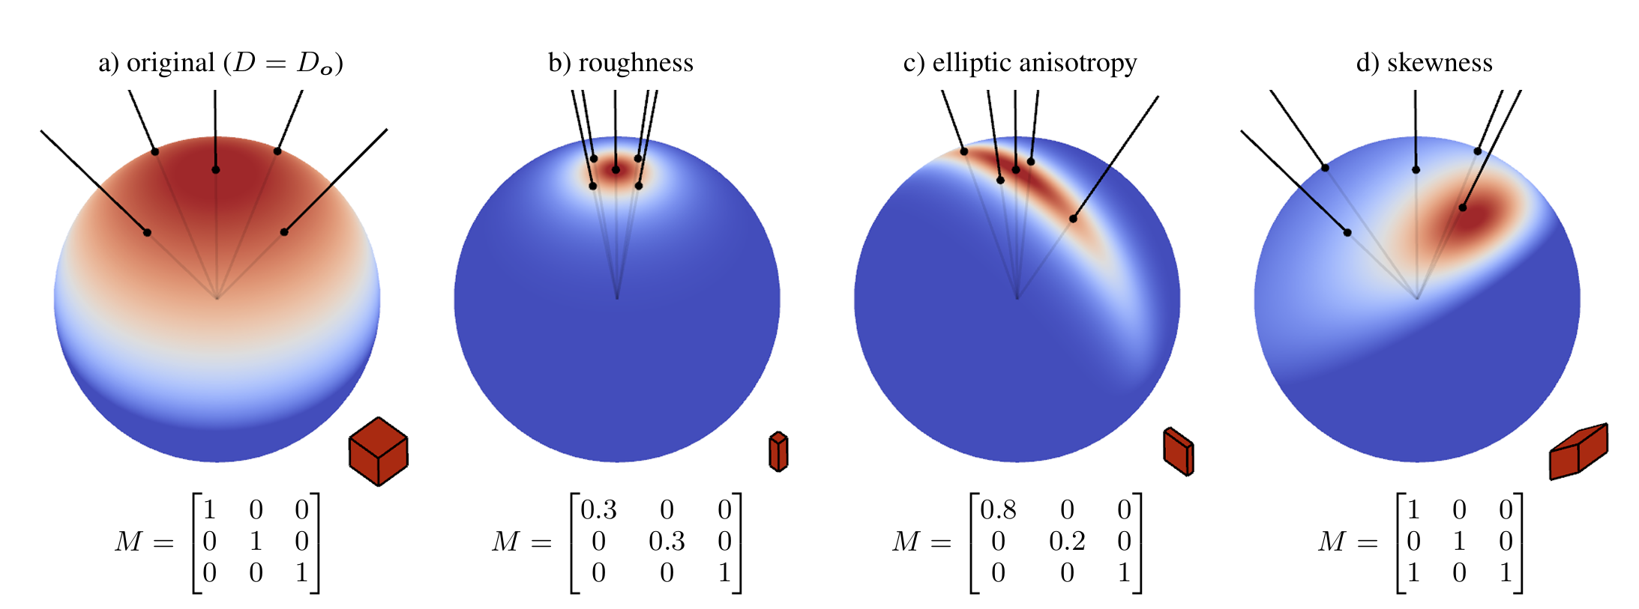
Linearly Transformed Spherical Distributions
A new kind of spherical distribution that solves these two problems.
Use original spherical distribution and apply a linear transformation(represented by a 3x3 matrix) to its direction vectors.

Slide 5
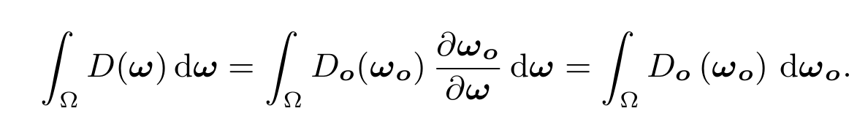
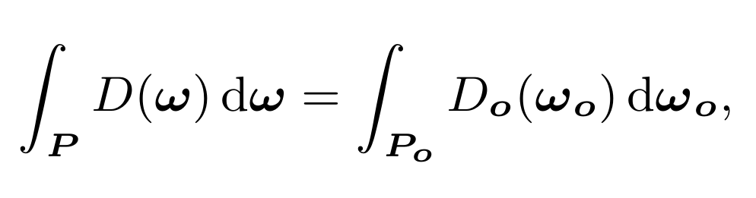
Linearly Transformed Spherical Distributions
The transformed distribution $D$ inherits several properties of the original distribution $Do.$
Normalization The norm of an LTSD $D$ is the norm of its original distribution $Do$.
Integration over Polygons The integral of an LTSD $D$ over a polygon $P$ is the integral of the original distribution $D_{O}$ over the polygon $P_{O} = M^{−1}P$

Slide 6
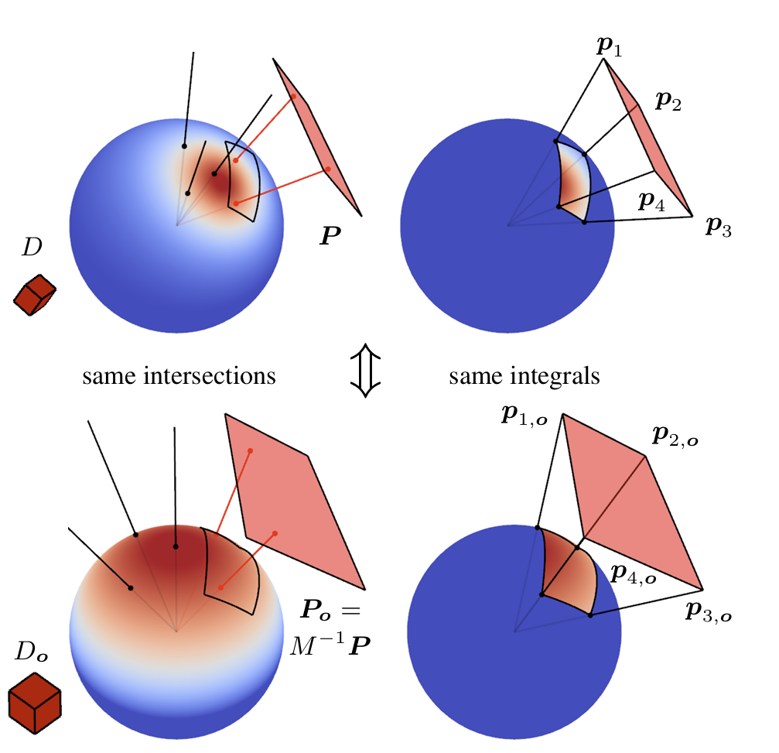
Linearly Transformed Spherical Distributions

Slide 7
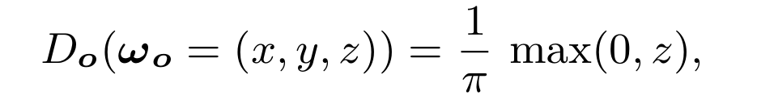
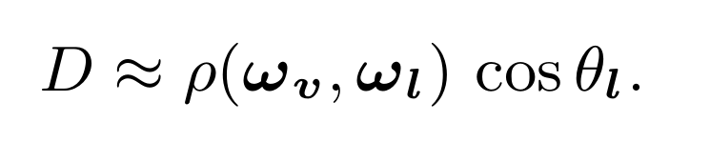
Approximating Physically Based BRDFs with LTC
LTC (Linearly Transformed Cosines)
For the original distribution $D_{O}$ we choose a normalized clamped cosine distribution in the hemisphere given by the z direction:
Fitting
Approximate the spherical functions given by the cosine weighted BRDFs over the light directions $ω_{l}$ ：

Slide 8
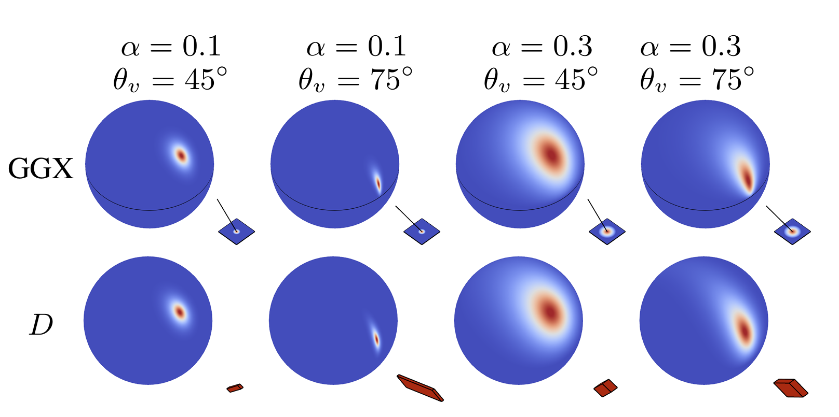
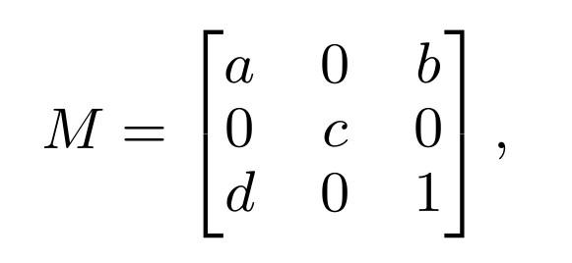
Approximating Physically Based BRDFs with LTC
For an isotropic material,the BRDF depends on the incident direction $ω_{v}$and the roughness parameter $α$. For any combination $(θ_{v},α$) we fit the cosine-weighted BRDF with a Linearly Transformed Cosine. Use the matrix M to fit:

Slide 9
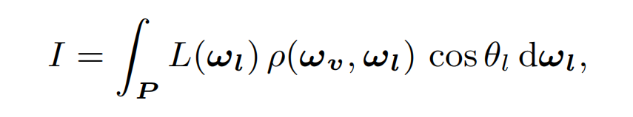
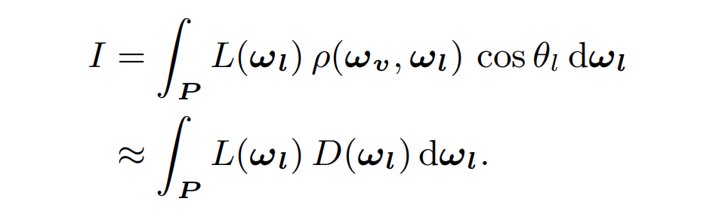
Real-Time Polygonal-Light Shading with LTC
Computing the illumination integral over a polygonal domain:
In order to use the properties of Linearly Transformed Cosines, at runtime we fetch matrix $M^{−1}$ of the Linearly Transformed Cosine $D$ associated with incident angle $θ_{v}$ and roughness $α$ of the BRDF.

Slide 10
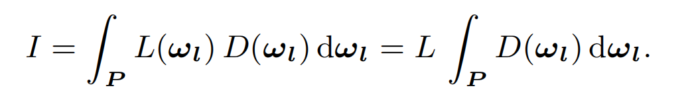
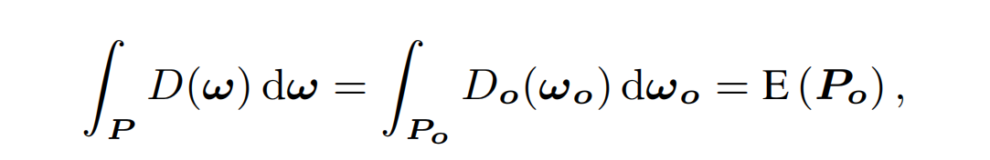
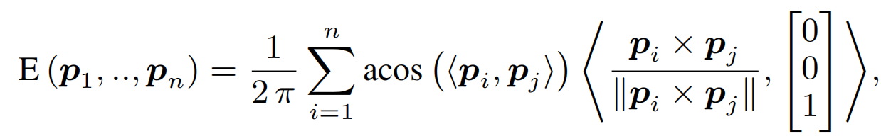
Real-Time Polygonal-Light Shading with LTC
If the radiance emitted by the polygonal light is spatially constant.
where $E$ is the irradiance of the polygon $P_{o} = M^{−1}P$
When calculating area lights, we need to integrate the radiance within the solid angle where the area light is located, but in practice we only need to integrate along the edges of the polyhedral light source.

Slide 11
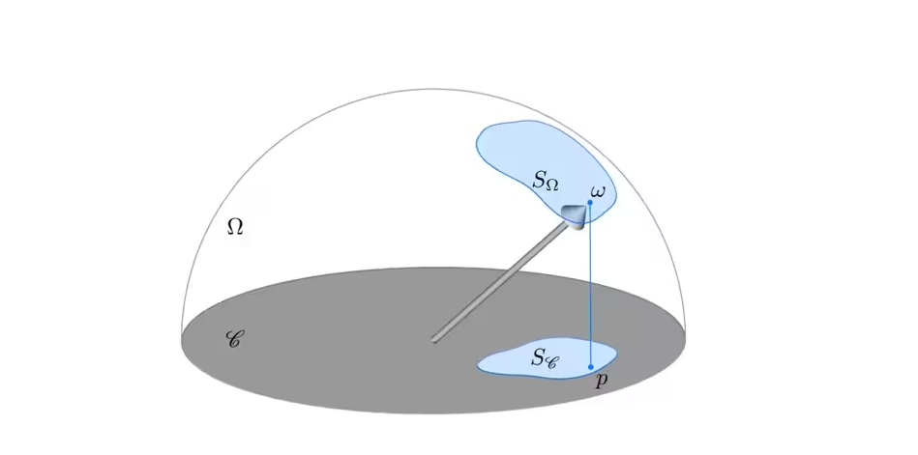
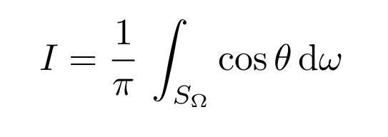
Real-Time Polygonal-Light Shading with LTC
Converting geometry face sampling to finite edge summation.
The irradiance of a hemispherical domain $S_{Ω}$ is generally defined as the integral of the cosine of these directions divided by $π$:

Slide 12
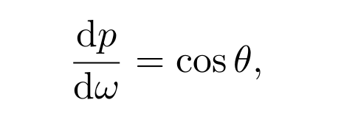
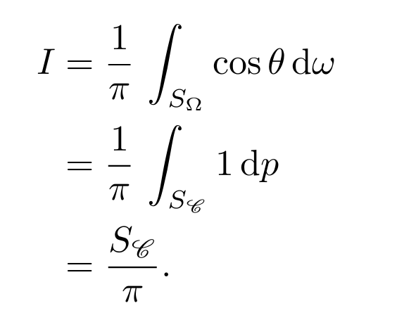
Real-Time Polygonal-Light Shading with LTC
The cosine factor in the expression can also be seen as the Jacobian of the projection onto the unit disk:
which allows for changing the integration domain:

Slide 13
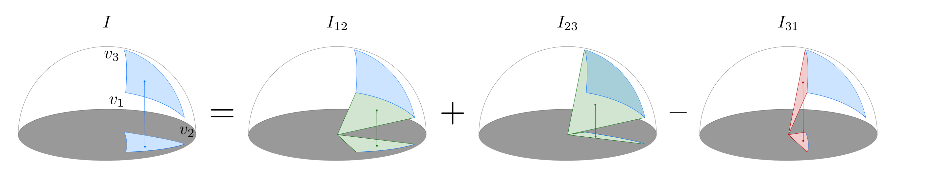
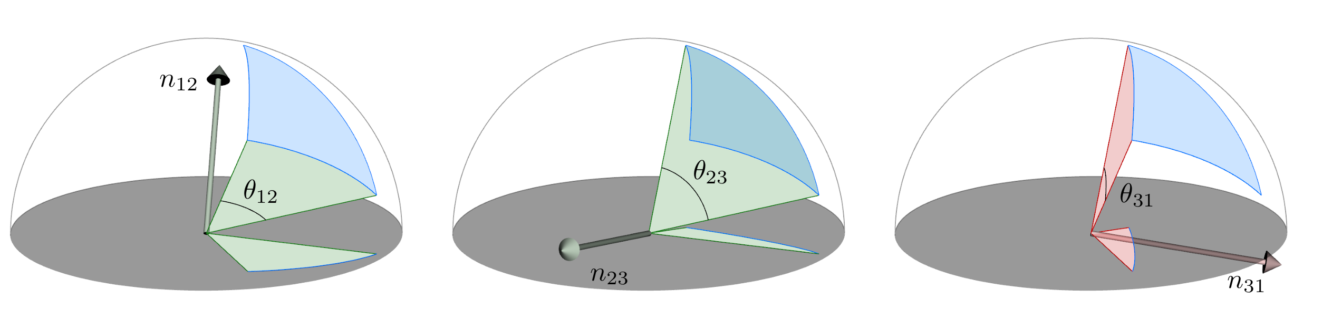
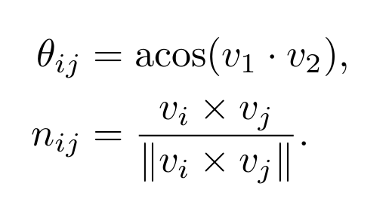
Real-Time Polygonal-Light Shading with LTC
The blue area is the sum of the (positive) green areas and the (negative) red areas.
Each edge $(V_{i} V_{j})$ of the polygon defines a disk sector defined by an angle $θ_{ij}$ and a normal $n_{ij}$:

Slide 14
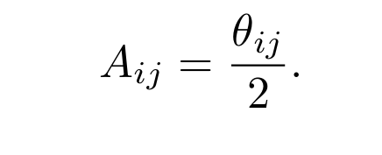
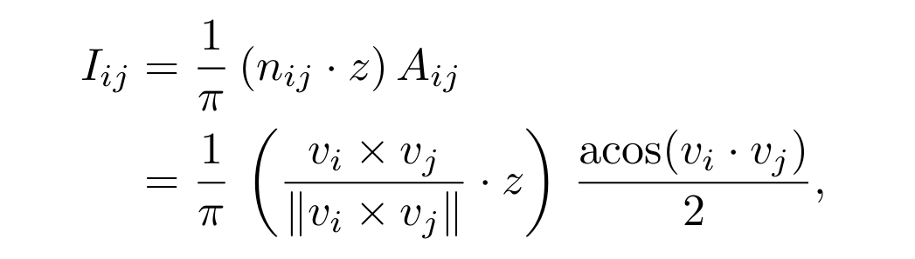
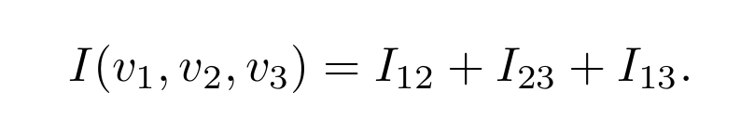
Real-Time Polygonal-Light Shading with LTC
The area of a disk sector is proportional to its angle:
Signed Irradiance of a Disk Sector
Irradiance of the Polygon

Slide 15
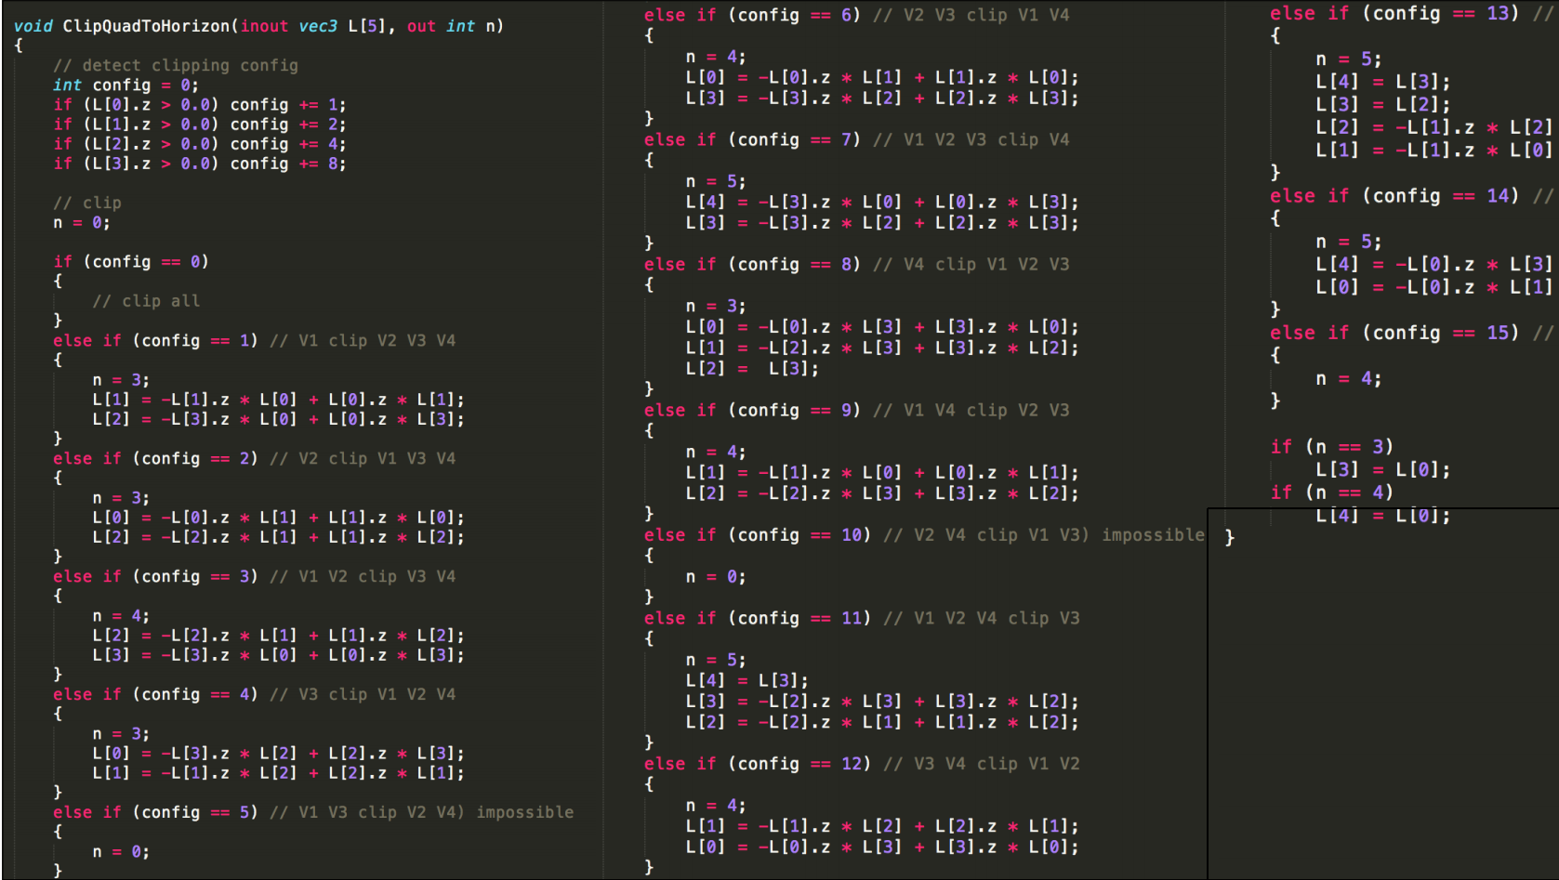
Real-Time Polygonal-Light Shading with LTC
Clip polygon to upper hemisphere
Solution 1: Calculate clip intersection points

Slide 16
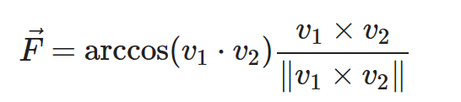
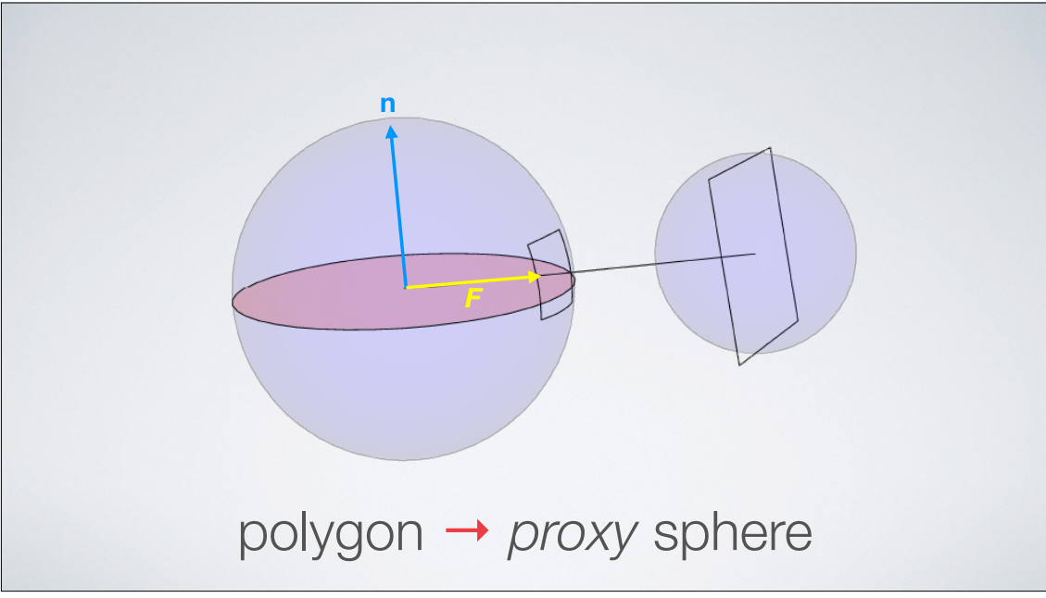
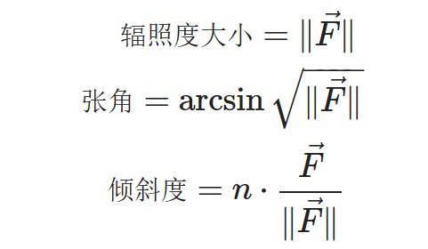
Real-Time Polygonal-Light Shading with LTC
Solution 2: Proxy Sphere
Remove the dot product with the surface normal (so that it doesn't project onto the plane)
Assume that the light source with irradiance of $||F||$ comes from a sphere (Proxy Sphere). Through vector $F$, we can get the angle and inclination of the circular surface relative to the cosine distribution function. The formula is as follows:

Slide 17
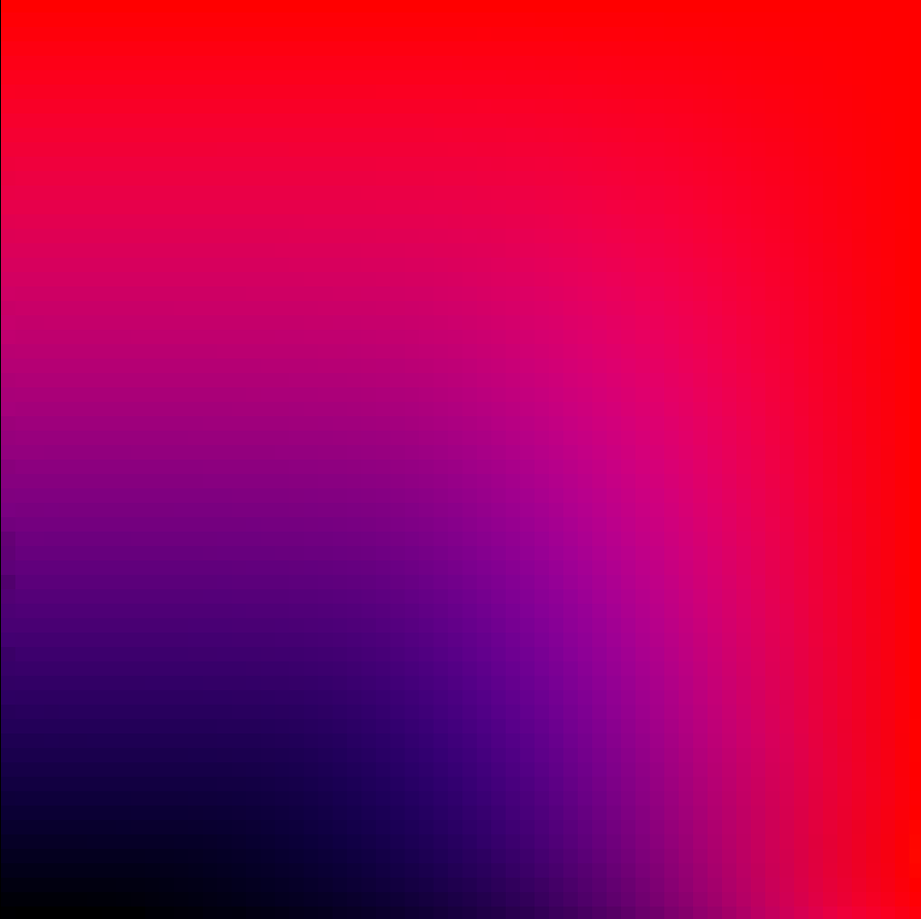
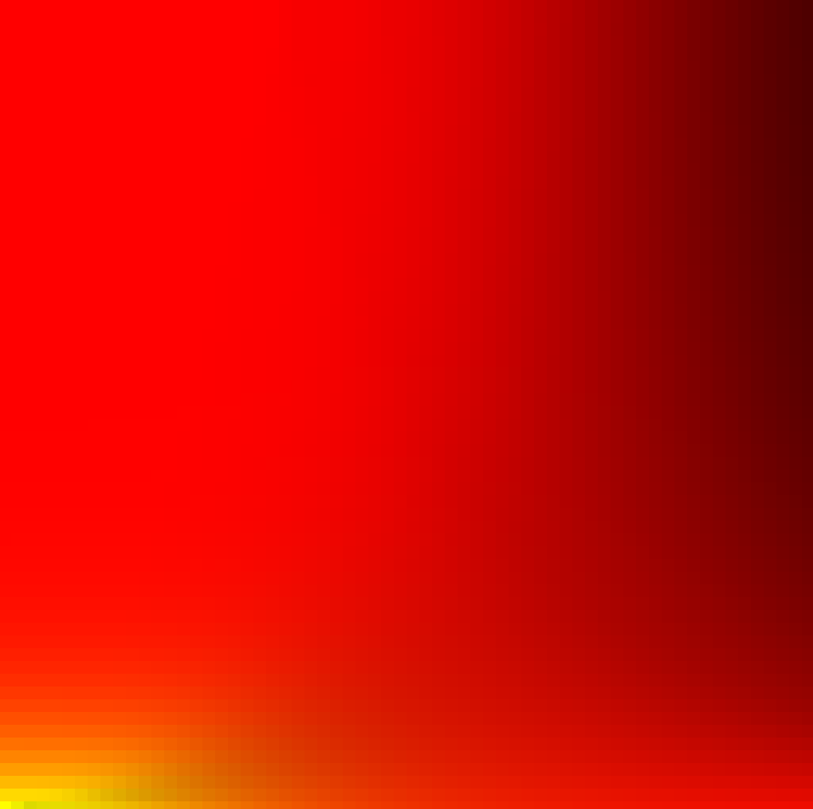
Real-Time Polygonal-Light Shading with LTC
LTC Precompute results

Slide 18
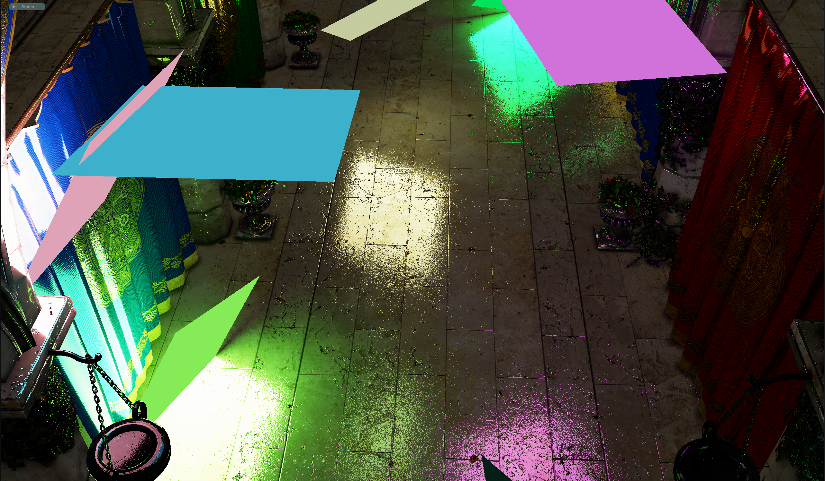
Real-Time Polygonal-Light with TBDR or CBDR
Add Polygonal-Light calculations to lighting partition optimization, such as TBDR, CBDR

Slide 19
References
Real-Time Polygonal-Light Shading with Linearly Transformed Cosines, ACM Siggraph LTC.pdf
Real-Time Area Lighting: a Journey from Research to Production, presentation slides by Stephen Hill s2016_ltc_rnd.pdf
Real-Time Polygonal-Light Shading with Linearly Transformed Cosines, presentationslides by Eric Heitz slides.pdf
Interactive WebGL-demo: blog.selfshadow.com
Main reference github repo: https://github.com/selfshadow/ltc_code.
Real-Time Polygonal-Light Shading with Linearly Transformed Cosines, Supplemental video showcasing the technique: Youtube
Linear-Light Shading with Linearly Transformed Cosines: HAL archives
实时范围光Area Light渲染及其数学原理推导，XDzZyq 笔记

Slide 20
Thank you!

